Slide 1

Graduate lab
Jiaqi Gu
Yuesen Lu (YL33489)

Slide 2

Outline
Brief summary of the RRIP cache replacement policy
SimPoint Setup
Quantitative evaluation
Analysis

Slide 3
1.1 DRRIP Cache Replacement Policy
不会解释。。

Slide 4
1.2 SRRIP Cache Replacement Policy
不会解释。。

Slide 5
2.1 SimPoint Setup
Number of SimPoints, length of SimPoints used
List of identified SimPoints and weights for each benchmark
这个我用excel打开那个列表排版是乱的…

Slide 6
2.2 SimPoint Setup

Slide 7
3.1 Quantitative Evaluation Metric
Miss Rate
When an attempt to read or write data from the cache is unsuccessful, it results in lower level or main memory access and results in a longer latency and this phenomenon is known as a cache miss. A good cache replacement policy should have low miss rate.
CPI
It is the average cycles per instruction in a given process. A good cache replacement policy should have low CPI.

Slide 8
3.2.1 System configuration
./build_champsim.sh ${BRANCH} ${L1D_PREFETCHER} ${L2C_PREFETCHER} ${LLC_REPLACEMENT} ${NUM_CORE}
a. branch prediction: Bimodal
b. L1 Data Cache : no, Next_Line
c. L2 Coherent Cache: no; Ip_Stride
d. LLC replacement policy : LRU; DRRIP; SRRIP
e. Core: 1
f. /inc/cache.h
i. LLC set = 2048 , 8192
ii. LLC way=8, 16

Slide 9
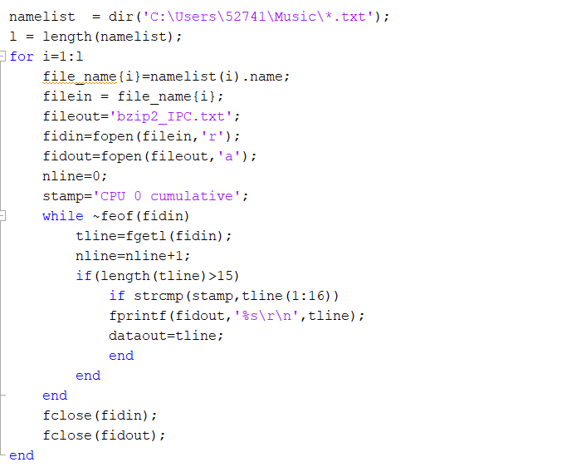
3.2.2 Data collection
The output files contain much information and we need to extract the key metric from hundreds of files. The Matlab script shown is used for data collection.

Slide 10
Miss Rate Evaluation

Slide 11
Miss Rate Evaluation

Slide 12
S-Curve

Slide 13
CPI Evaluation

Slide 14
CPI Evaluation

Slide 15
S-Curve

Slide 16
4. Analysis
Both DRRIP and SRRIP have slightly lower miss rate and lower CPI than LRU on most benchmarks. And DRRIP has better performance than SRRIP on most benchmarks.
One possible reason is that the locality over long-interval re-reference in these benchmarks rarely happens. So the advantage of RRIP is not fully utilized.

Slide 17
4. Analysis
Overall, DRRIP has best performance in most scenarios. It should be recommended…

